Slide 1




SitterConnect App Presentation
Presented by: Abdi Lina Amel
Supervised by:

Slide 2


Table of contents:
Introduction (Context & Problem statement)
1
2
Overview of SitterConnect
3
Features of the application
4
Conception/Diagrams
5
Technologies used
6
Conclusion

Slide 3

Context
My project focuses on developing a web and mobile application that connects parents with trustworthy babysitters.Today’s parents face challenges in finding reliable childcare services that meets their needs.

Slide 4


Problem statement:
Finding a reliable, trustworthy babysitter nearby and who meets their needs is a real struggle for parents who have to work and sometimes they have no choice but to work from home and as you can see from the pictures, work and taking care of your children do not mix well.

Slide 5

Problem statement:
Meanwhile, babysitters are facing difficulty accessing suitable job opportunities

Slide 6


SitterConnect is a user-friendly application dedicated to facilitating the connection between the parents and trustworthy babysitters.
Solution

Slide 7
Objectives:
1
2
3
Connecting parents with babysitters who fit their needs.
Registering on the application grants babysitters employee status, offering CNAS insurance coverage for work-related accidents.
generate revenue by:
Offering a premium subscription plan with extra features.
Charging a commission on each booking made through the application.
Implementing a referral program to reward users for referring new clients.

Slide 8

Application’s features
Functional
non-Functional

Slide 9
Application’s features
Functional requirements
users can manage their accounts.
babysitters can confirm or reject a reservation.
users can manage their profiles.
Parents can make reservations.
Parents can filter their search for a babysitter.

Slide 10
Application’s features
Security
non-Functional requirements
scalabilty
Performance
reliability
user-friendly interface

Slide 11
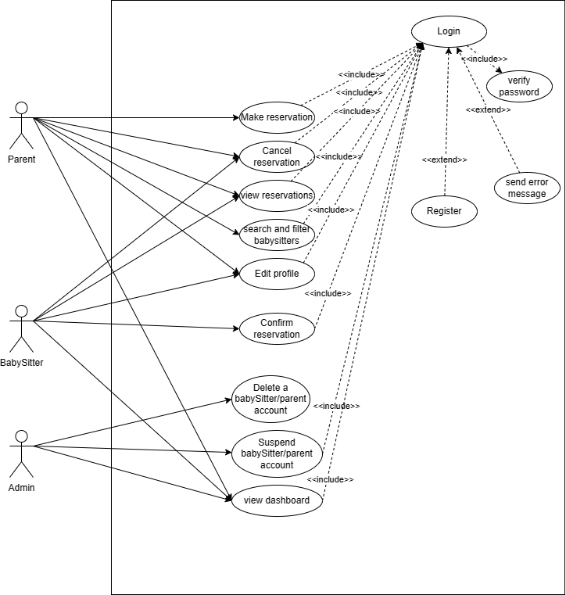
Conception/Diagrams
Use Case Diagram

Slide 12
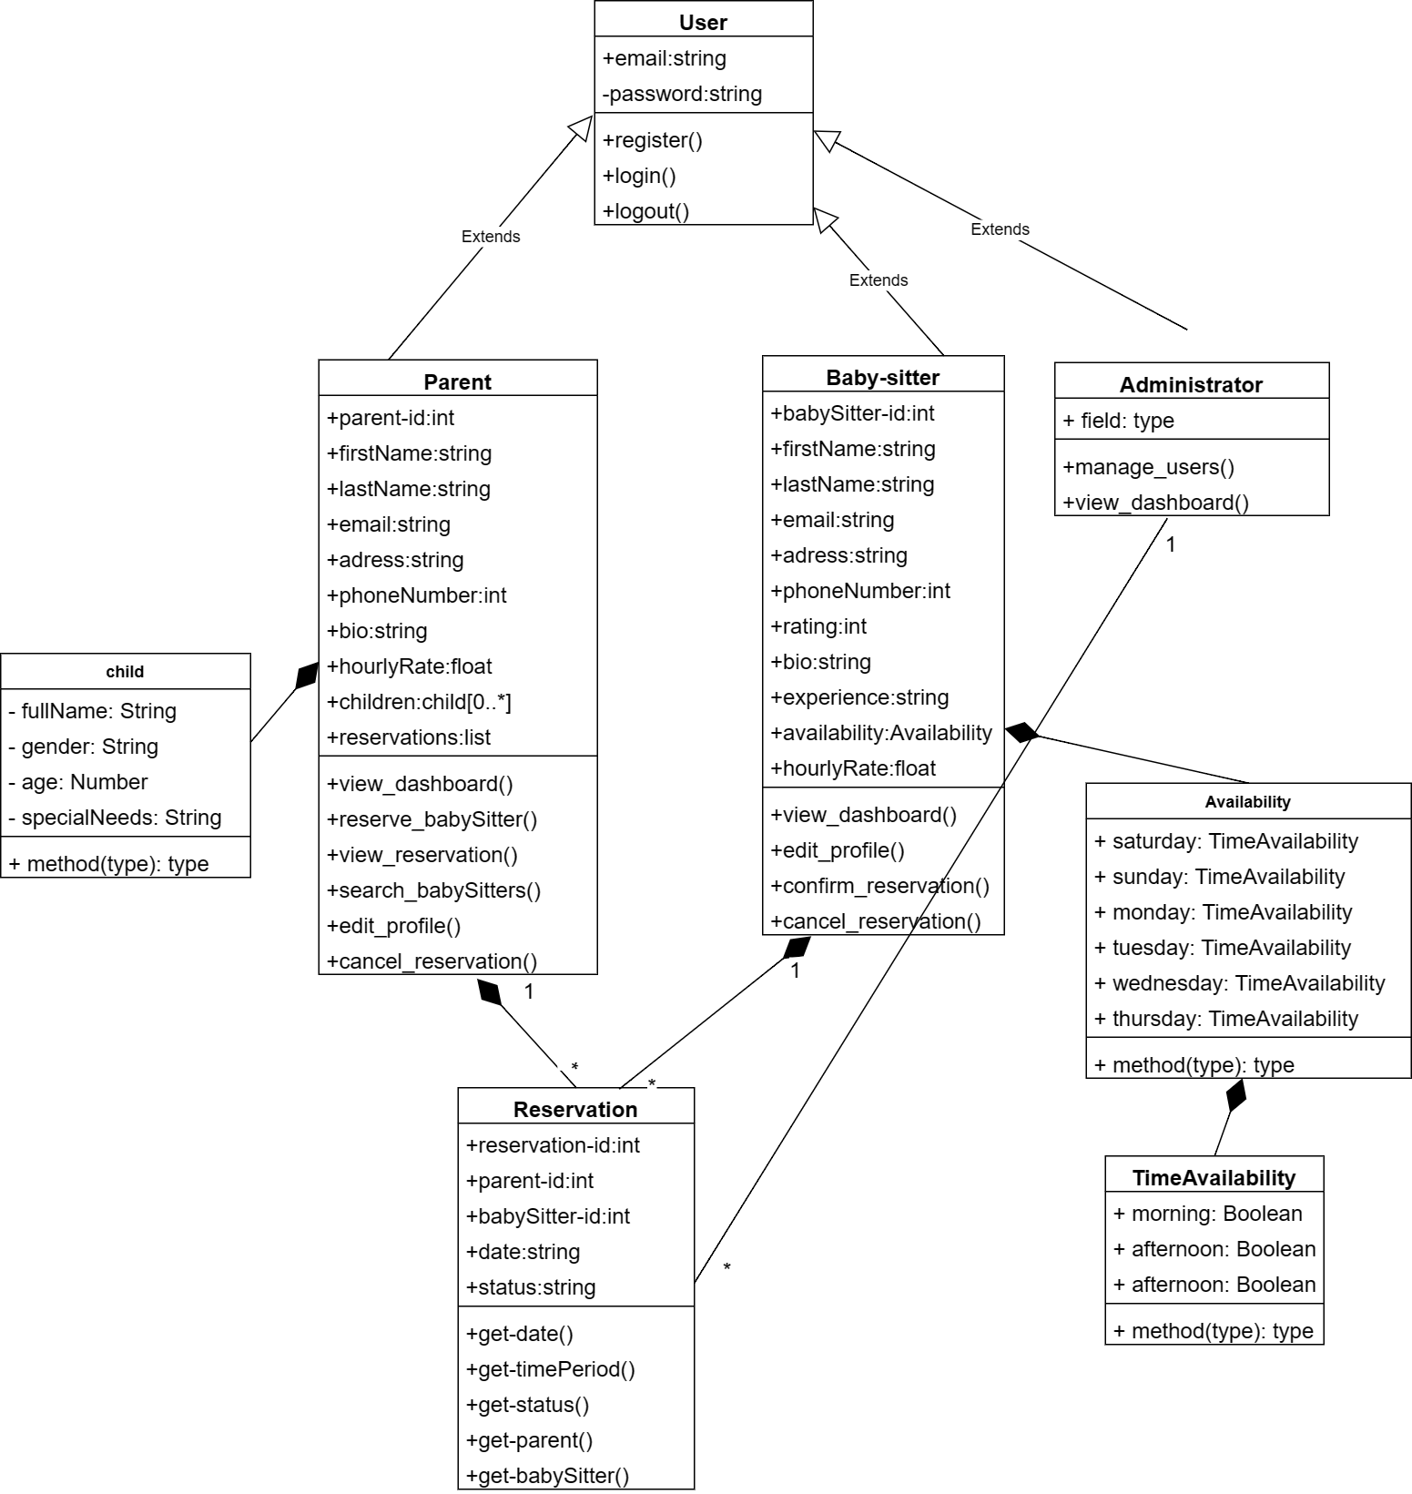
Conception/Diagrams
Class Diagram

Slide 13
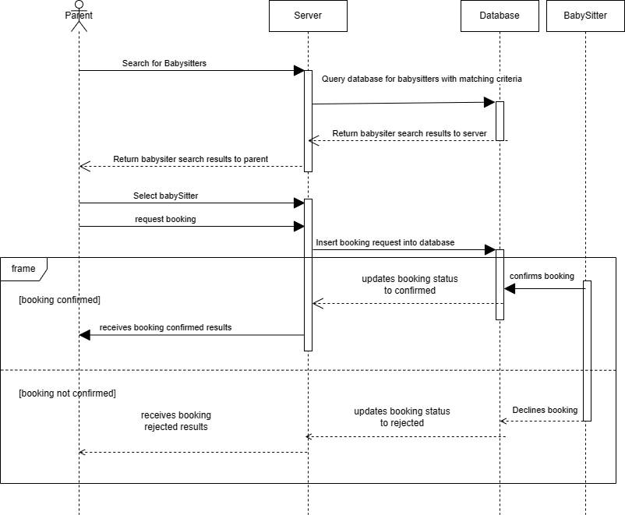
Conception/Diagrams
Sequence Diagram Booking Activity

Slide 14
Project planning
01/02/2023
15/02/2023
01/03/2023
01/05/2023
24/07/2023
Brainstorming for a project idea
Working on cahier des charges, figma and conception diagrams
Working on the backend on the application
Working on the front end of the application
Presenting my project to the members of the jury

Slide 15









Technologies used

Slide 16
Conclusion
In conclusion, this project represents a significant step in the childcare industry with my dedicated web application aimed at facilitating the connection between parents and babysitters. I have shared my vision for this application and the key features developed so far.
As a junior developer, I am aware of the challenges ahead, but I am also excited to continue progressing and improving the application, relying on industry best practices. My determination is to create an application that simplifies the lives of parents and babysitters, providing them with a pleasant experience.
Lastly, I express my gratitude to all those who have supported and provided guidance for this project. Your support is crucial in this journey. Thank you for your attention, and I am available to answer any questions.

Slide 17


THANK YOU FOR YOUR ATTENTION

